Slide 1

Sunflower
(PMP M80)
Project Open Stage Gate
Department: End-User Control Platform
SG Date: 25/01/2013
Notes:
Template of Project report in PSC for PPR (Project Progress Review)

Slide 2
Marketing
Leo Wang

Slide 3
What is CSP
Concentrating Solar Power (CSP) technology uses reflective materials to concentrate the sun heat to drive a conventional power cycle.
Current technology of CSP
  Parabolic trough - Commercially proven
  Solar power tower – Pilot commercial
  Fresnel reflectors - Pilot
  Dish Stirling - Demonstration
Source: IRENA reports – Renewable energy technologies: cost analysis series – Concentrating Solar Power
Tower
Parabolic

Slide 4
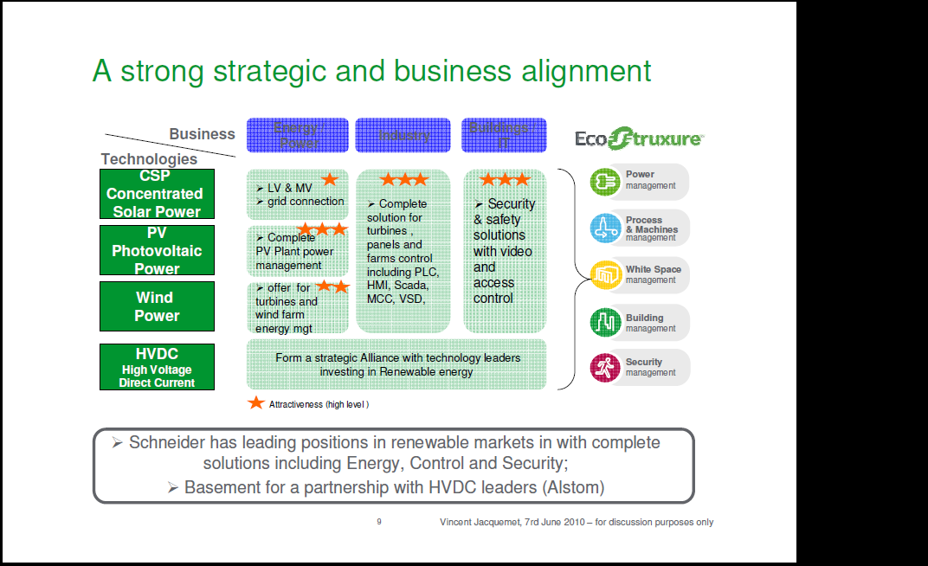
Business
Fit SE and Plant solution

Slide 5
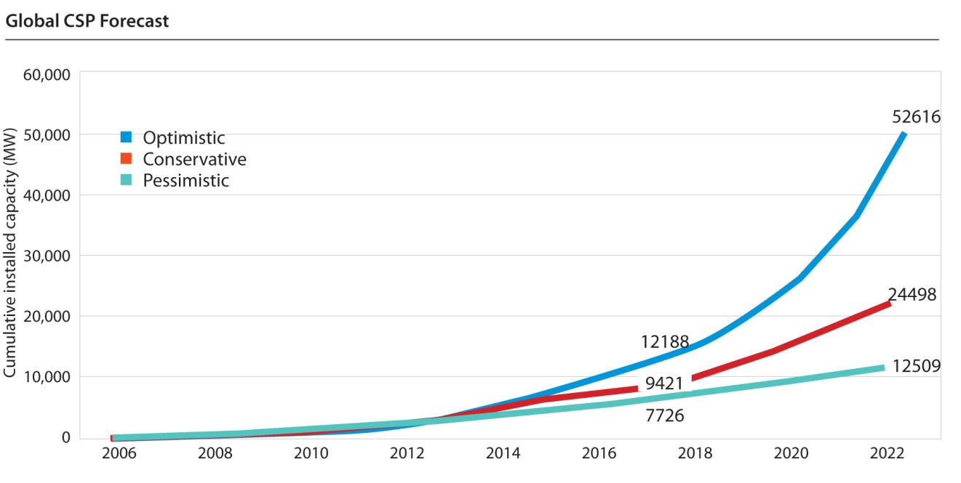
Business
Booming CSP market
M80 delivery
Source: 2012 CSP INDUSTRY MARKET FORECAST AND OUTLOOK of CSP Today

Slide 6
Business
Strong partnership
There are 2 major EPCs in CSP market that SE has accessed, Sener (30%) and Abengoa (70%).
  Sener is a historical SE customer which promotes PlantStruxure Ethernet solution. This is our primary target for M80.
  Abengoa is a historical Telvent customer which promotes a solution very different to PlantStruxure Ethernet solution. It’s expected that Abengoa will in the mid term move toward PlantStruxure Ethernet solution.
  Example of operating plants
    For Sener: Gemasolar CSP tower project and several CSP parabolic projects
    For Abengoa: 3 CSP tower projects (PS10 : 11 MW, PS20: 20 MW, Eureka) and tens of CSP parabolic projects are in operation.
Now we have many CSP projects in pipeline
  More projects with over 20,000 PLC consumption in 2 years.

Slide 7
Origin of the offer
The origin of this project is to provide a just-enough Unity PAC (M340 is considered too expensive when facing competitors’ challenge) for booming CSP market
  Currently, the CSP market is not mature; all the CSP projects need strong financial support of government. But the government subsidies are just short term solution, eventually the cost/watt of CSP need to become competitive in the market.
  As CSP technology becomes mature and commercial, the customer will be more sensitive for the project cost.
  With M80, we will keep our leading position in CSP market in both automation technology and project cost.
  Customer will benefit from EU advantage of this M80 offer, such as Unity pro support, full PlantStuxure architecture, EU robustness, etc.

Slide 8
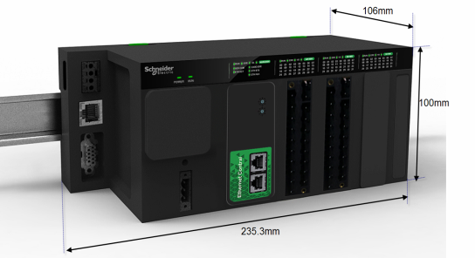
Offer definition
2 new Compact CPUs (Part number and product family TBC)
Communication
  Upstream:
    2 Ethernet ports (1 MAC)
  Downstream:
    1 MB master,
    1 CANopen master,
  Terminal:
    1 USB device
Power supply
  Embedded 24VDC
Embedded IO
  BOX1: 8DI, 8DO, 2HSC
  BOX2: 8DI, 8DO, 2HSC and 4AI
SD card& USB
Module and IO Status indicators
Serial Link
CANopen link
Power supply
Ethernet w/ embedded switch
IO boards
  → The only difference between box1 and box2 is integrated analog input channels.

Slide 9
Marketing position
Targeted Application
  Concentrated Solar Power (Parabolic through and Tower technology)
Country ranking
  Spain
  USA
  South Africa
  India
  Other countries
Currently, M80 is a dedicated controller for CSP application. It is considered as an optimized and compacted M340, which is tailored to provide just enough performance and functions.
→ In long term, M80 (if it becomes a new PAC range) will fill the gap of Plant solution PAC portfolio for small configuration.

Slide 10
Marketing Goal
Offer an cost effective Unity controller for CSP application
  The controller will provide just enough function and performance for current and near future CSP application
Offer a step-wise approach to fill the entry level of the PlantStruxure range of controllers (If we choose to enlarge M80 platform as a new entry level Unity controller platform)

Slide 11


Proposed architecture
SCS level
Full Ethernet architecture
Redundant copper ring in device level
Maximum 40 devices per sub ring (2 M340 with BMXNOC, 38 M80 controllers)
VRRP layer III
VRRP layer III
DSR
DSR
RSTP ( max 40 devices, copper or F.O)
RSTP 1 Primary Ring
Dual RSTP Master
Dual RSTP Slave
Dual RSTP Master
Dual RSTP Slave
Dual RSTP Master
Dual RSTP Slave
DSR
DSR
DSR
DSR
DSR
DSR
M340 + NOC
M340 + NOC
M340 + NOC
RSTP 2 Secondary Ring
RSTP ( max 40 devices, copper or F.O)
RSTP ( max 40 devices, copper or F.O)
RSTP ( max 40 devices, copper or F.O)
RSTP ( max 40 devices, copper or F.O)
RSTP 3 third Ring
RSTP 4 fourth Ring
M80
M80
M80
M80
M80
M80

Slide 12
Cost Comparison and UVP
Cost Comparison
UVP
  Entry level Unity controller that provide just enough function/performance for CSP application
  Fully integrated in PlatStruXure
  Cost effective → Save 330€ in each configuration (491€ -161€)
  EU level robustness and reliability
CSP Configuration | 8 Dig in, 8 Dig out, 2 EHC | 8 Dig in, 8 Dig out, 2 EHC and 4 Ana in
M80 Reference cost (COGS) | 145€ *BMKC18332F BMXFTB2020 BMXFTB2820 | 176€ *BMKC18332F4M BMXFTB2020X2 BMXFTB2820
M340 Reference cost (COGS) | 479.25€ *BMXCPS2010,BMXXTSCPS10 BMXP3420102,BMXEHC0200 BMXXTSHSC20,BMXDDM16022 BMXFTB2020,BMXXBP0400 BMXNOC0401,BMXRMS008MPF | 548.74€ *BMXCPS2010,BMXXTSCPS10 BMXP3420102,BMXEHC0200 BMXXTSHSC20,BMXDDM16022 BMXFTB2020X2,BMXXBP0600 BMXAMI0410,BMXNOC0401, BMXRMS008MPF
Saving | 69.7% | 67.9%

Slide 13
Competition
In CSP application, SE can provide very complete control system solution, include SCS, DCS, Medium Voltage Devices, Low Voltage Devices and Active filters. And with partner Sener and Abengoa, SE can deliver complete turnkey solution for CSP plants and provide consultant and service.
Our competitors mainly focus on CSP parabolic market now. They don’t provide equivalent solution as SE in CSP Tower market.
ABB
  ABB with its technology partner Novatec Solar, delivers a complete turnkey solution comprising solar boiler, solar field, power block (including turbine, air condenser, electrical generator, pumps, all thermal cycle exchangers and piping), electrical balance of plant, plant automation system and grid connection.
  They provide AC-500eCo PLC and inverters for tracking.
  →http://www.abb.com/industries/us/9AAC166917.aspx
Siemens
  Siemens provides some components of CSP plants, including boiler, turbine, generators. As for tracking, they offer S7-1200 as controller.
  →http://www.energy.siemens.com/mx/en/power-generation/power-plants/csp-power-block/
Rockwell
  Allen Bradley only provides a solution of control system, including Contrologix and Micologix.

Slide 14
Sales Forecast & ASP
SE sell M80 in the package of CSP project, normally no break down price for each product.
  Here we set NSP of M80: 350€, it is an estimated price of M80 controller only. There is not split price for each reference
With M80, SE will defend current market share and keep same growth rate as CSP market
Forecast in quantities
Sener only
Sener + Abengoa
Year | 2014 | 2015 | 2016 | 2017 | 2018 | 2019
Units | 10,000 | 20,000 | 30,000 | 50,000 | 80,000 | 120,000

Slide 15
Summary – SENER projects
Project name | Country | Type/power | M80 qtties | Proba success w/ M80/M340/Other | Cost saving w/ M80 | 1st M80 del date
Pedro Valdivia | Chile | Para 360MW | 1200 | 65%/10%/35% | 396 K€ | Q4 2013/Q1 2014
Ouarzezate | Morocco | Para | 1200 | 65%/10%/0? | 396 K€ | Q4 2013/Q1 2014
ARGELIA | Algeria | Tower 50MW | 7000 | TBC | 2.31 M€ | TBC
ESKOM | South Africa | Tower 100MW | 14000 | TBC | 4.62 M€ | TBC
UPINTONY | South Africa | Para 55MW | 180 | TBC | 59.4 K€ | TBC
IBEREOLICA | Chile | Tower 50MW | 7000 | TBC | 2.31 M€ | TBC

Slide 16
Project
Robin Wan

Slide 17
Project objectives & Assumptions
  Project scope
    Two references
    Unity V8.1 or V9
  Main Objectives:
    Targeting countries: Spain, United States & Canada, South Africa and India etc.
    Targeted segments: Electric energy – CSP Heliostat control
    Coincidental with Unity Pro v8.0 SP1 (TBD)
  Major Constraints:
    CCV : type 1 < 150€, type 2 < 180€
    Higher operation temperature range impact on cost and quality (M340: 0~60 °C , M80: -10~70 °C )
    SW resource availability to consider constrain from M580/Momentum Unity
    Platform/common firmware strong related with Momentum Unity/M580
    The agency approval must follow M340 range
    Same quality criteria with M340 range
Commercial Ref | PV | SV | Description | Range
BMKC18332F | 01 | 1.0 | M80 TYPE 1 controller for CSP, 8 Dig in, 8 Dig out, 2 EHC | M80
BMKC18332F4M | 01 | 1.0 | M80 TYPE 1 controller for CSP, 8 Dig in, 8 Dig out, 2 EHC and 4 Ana in
Notes:
?? To find the contents for this page.
To add more information about how to right and which tools to use.

Slide 18


Project organization
Carros
Unity development
System arch
Techpub
UL certification
AOCC
- Project management
- R&D
- Final integration
V&V Test
WPF plant (TBD)
Purchasing

Slide 19
Project organization
Role | Name | Department | Remarks
Project Manager | Xiaohui Wan | AOCC
Project Marketing Leader | Lei Wang | AOCC
Project Design Leader | Jianguang Wang | AOCC
System Arch | TBD | Carros PlantSolutions/Control | System arch between FW & SW
Software Leader | Philippe Defert | Carros PlantSolutions/Control
Firmware Leader | Jiangguang Wang | AOCC
Hardware Leader | Fei Chen | AOCC
Mechanical Leader | Xueyi Zhang | AOCC
Industrialization Leader | Xiaowei Chen | AOCC
Purchasing Leader | Weihua Huang | AOCC
Quality Leader | Yang Cao | AOCC
Test Leader | Xiaowen Shu | AOCC | Test coverage; Sync Veri & Val
Verification Leader | Xiaowen Shu | AOCC
ENV Validation Leader | Shougang Liu | AOCC
FUNC Validation Leader | Kai Peng | AOCC
Techpub Leader | TBD | Carros PlantSolutions/Control

Slide 20
Project Macro Schedule
Stage Gate | Target Date
OPEN | Jan 24 2013
SELECT | Mar 7 2013
DO | May 16 2013
SELL | June 2014
CLOSE | Sep 2014
€
OPEN
SELECT
DO
2013
IMPLEMENT
2014
PRODUCE
SELL
Jan
Feb
Mar
Apr
May
Jun
Jul
Aug
Sep
Oct
Nov
Dec
Jan
Feb
Mar
Apr
May
Jun
PCO
PS
TS
FW & SW development
Bug fix
MIR
Plan Veri
Incremental Veri
Final Veri
Func Val
Ref
Eng Proto 1
Eng Proto 2
Mfg Proto.
PR
MP
Env Veri
V4
Symphony
Env Val
FUI
R4M
ICT
MP
PR
FCT + Line Adapt.

Slide 21
Project costs Estimation
In man month
In K€
PMP M80 | 2013 | 2014 | Sub-Total
AOCC Total (mm) | 135.1 | 42 | 177.1
AOCC-Control (mm) | 117.2 | 26.7 | 143.9
PM (mm) | 9 | 4 | 13
HW (mm) | 27 | 4.8 | 31.8
ME (mm) | 24 | 2.2 | 26.2
FW (mm) | 32.2 | 6 | 38.2
PCB (mm) | 8 | 0 | 8
MKT (mm) | 2 | 0.7 | 2.7
Verification (mm) *Unity veri included | 20 | 10 | 30
AOCC-Q&C (mm) | 5 | 18 | 23
Fuc Val(mm) | 4 | 16 | 20
Env Val(mm) | 1 | 2 | 3
AOCC-Industrialization (mm) | 8.1 | 2.8 | 10.9
AOCC-Purchasing (mm) | 4.8 | 1.3 | 6.1
Carros Total (mm) | 19.7 | 8.4 | 28.1
System Arch (mm) | 1.2 | 0.4 | 1.6
TechPub (mm) | 3.5 | 0.5 | 4
Unity (mm) | 15 | 5.5 | 20.5
Certification (mm) | 0 | 2 | 2
PMP M80 | 2013 | 2014 | Sub-Total
AOC-C Total (K €) | 954.9 | 325 | 1279.9
VA (K €) | 794.4 | 305 | 1099.3
CL6 (K €) | 160.5 | 20 | 182.5
CL2 (K €) *Not included into project cost and just for COGS and factory allocation inform | 285 | 0 | 285
Carros Total (K €) | 243 | 120.9 | 363.9
VA (K €) | 243 | 120.9 | 363.9
CL6 (K €) | 0 | 0
Total (K €) | 1197.9 | 445.8 | 1643.7

Slide 22
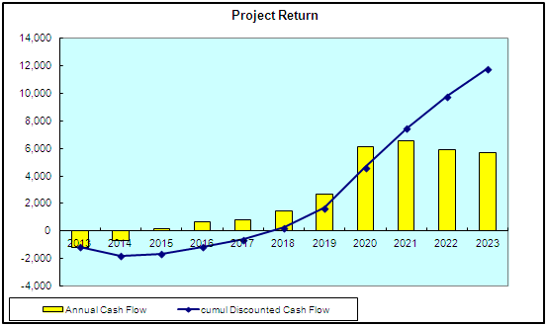
Project Profitability Estimation
Consumptions
  TER target (TBD)
  NSP Target (TBD)
  * SE will sell M80 in project mode, there is no break down price for each product
  * As an input of Onyx, we use 350EUR for NSP.
  * TER and NSP will be provided later, when we launch these references to all countries.
  CCV target (OTM estimation)
    BMKC18332F 145 €
    BMKC18332F4M 176 €
  Some positive impacts not included in Onyx
    Improve project price flexibility
    Improve probability of winning bid
    Directly pull through
    - Upstream SCS system
    - MV, LV Devices
    - Service and consultant
Profitability (w/o pull through)

Slide 23
Project Risks
  [High] Tight schedule for TTM (CSP project bid timeline)
    Clear scope (CSP only for PMP M80)
    Maximum reuse and just enough (OTM architecture, developed products/modules)
    Good sync inside and outside project
  [High] SW resource availability
    Define a good scenario to consider constrains from M580 & Momentum unity project
    (Unity V8.1 or V9?)
  [Medium] Platform/common firmware strong related with Momentum unity/M580
    Define firmware development strategy and SCM plan
    Keep closely sync with Momentum unity/M580
  [Medium] SW & FW sync due to limited knowledge on system
    Assign a system arch for facilitating SW & FW sync

Slide 24
Next Steps
  SW/FW development scenario definition
  OR analyze
  Key point list and following before SELECT
  PCO update
  PS kick off

Slide 25
Decision

Slide 26
Stage gate synthesis
Risk assessment of the stage gate | % of progress of the deliverables | General comments
Major
99%
100%
80%
60%
0%
Minor
No risk
1. Need to further check System arch and techpub resource before SELECT
2. Define key point (including HSC and MSU etc.) list before SELECT

Slide 27
PSC approval for Open
Who | Role
Jiajun Mo | AOCC Plant Solution R&D Manager
Haidong Chen | AOCC PMO
Ming-Allen Sun | AOCC Industrial Manager
Janice Tang | AOCC Purchasing Manager
Sylvain Olier | AOCC Marketing Manager
Guanhong-Grace Wang | Plant Solution PMO
Antonio Chauvet | Plant Solution R&D director
Franck Dery | Plant Solution SW manager
Decision
Comments if any.
Legend
Stage gate is approved without restriction.
Stage gate is refused. Second chance to pass the stage gate is given to the project manager.
Stage gate is refused. Project is stopped.
If you can read this text, please change the background color of the sheet in PowerPoint.

